Slide 1



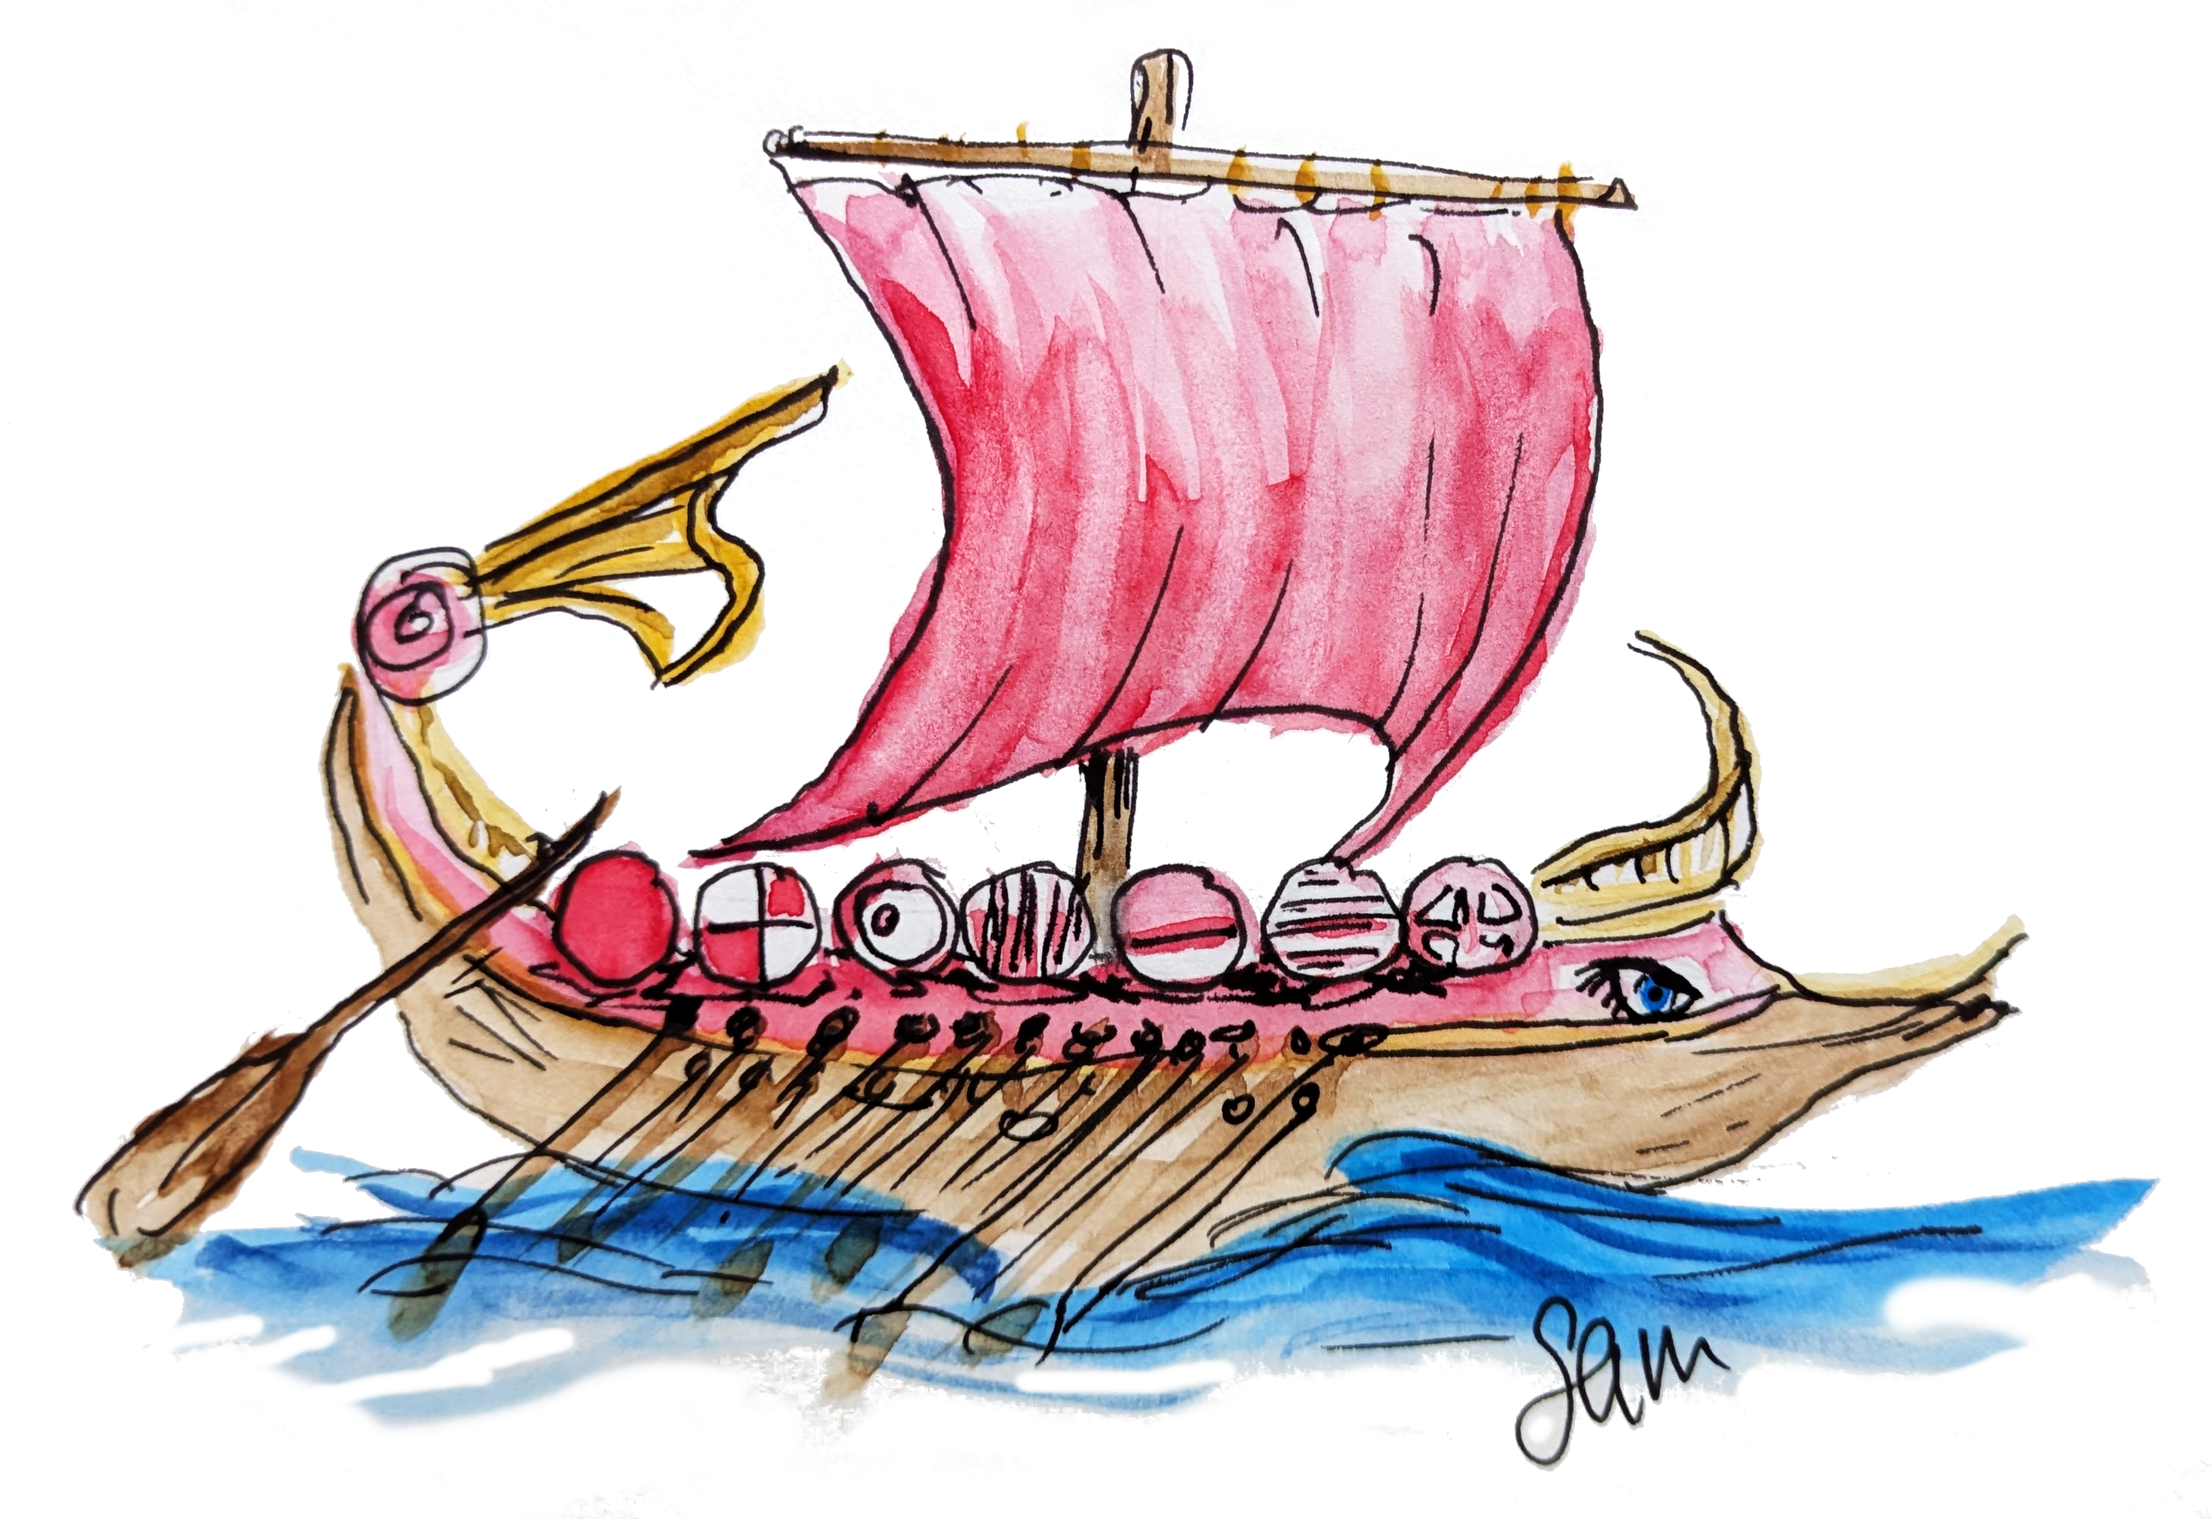
Contextual Embeddings
The HOdyASsey
Samantha Frohlich, Jessica Foster,
Alex Kavvos and Meng Wang
Notes:
Thank you for the introduction / Hello everyone, my name is Sam and I am junior faculty at the University of Bristol
Today, I plan to take you on a journey to explore a classical problem in Programming Languages:
that of the syntactic representation of embedded languages with binders
---
PLDI 2026
Slot = 20mins => 15min-17min talk, 3-5mins for questions / set up
Time = 16min 55s
Pre-presentation checklist:
Be in room 15mins before session
Take off lanyard to present (before mic)
Takeaways
Precise: The host’s type class instance resolution mechanism can be used to automatically calculate the correct de Bruijn index when the context is maintained and accessible in the term’s type using the following observation: The difference in size between the binding site context and the use site context is exactly the de Bruijn index
Snappy:
Problem: syntax with binding is hard
Observation: The difference in size between the bind site context and the use site context is exactly the de Bruijn index – levels vs DB
Gain: thus the de Bruijn can be calculated with the host’s instance resolution mechanism
Condition: As long as, you don’t throw away the typing context
ICFP: 2 useful/inspirational nuggets
Observation about bind site and use site
Using singletons to carry useful type info that can become something cool with type class res logic programming
PLDI: please use a contextual embedding (must understand unembedding, cos that’s the main selling point)
Contextual embeddings are great for when you want control over the binders, but hoas niceties
Gains – linear/modal types, all the eval usability stuff
WHAT CE is and WHY/WHEN they would wanna use it
Technique is agnostic to type setting hence works in linear etc

Slide 2

eDSLs
😴 Compiler
😅 Parser
😮‍💨 Type system
🫣 Interpreter
🫠 Profiling
😱 Optimisations
🤬 IDE support
❤️ Expressive
❤️ Focused
❤️ Tailored level of abstraction
❤️ Efficient
❤️ Safe
❤️ Metaprogramming
let / λ
Notes:
Now, I am sure that in the DSL session, I don’t need to motivate why DSLs are so great and why we love them
We’ve already seen how great DSLs can be with Scion, presented in the previous talk.
My favourite flavour of DSLs is embedded DSLs, simply because I am too lazy to do all the work that goes into standalone languages
Of particular interest today is the syntax of embedded languages with binders, that is language constructs that close over or “bind” variables such as let or lambda
---
Time so far = 35s
(Time for section = 35s)

Slide 3
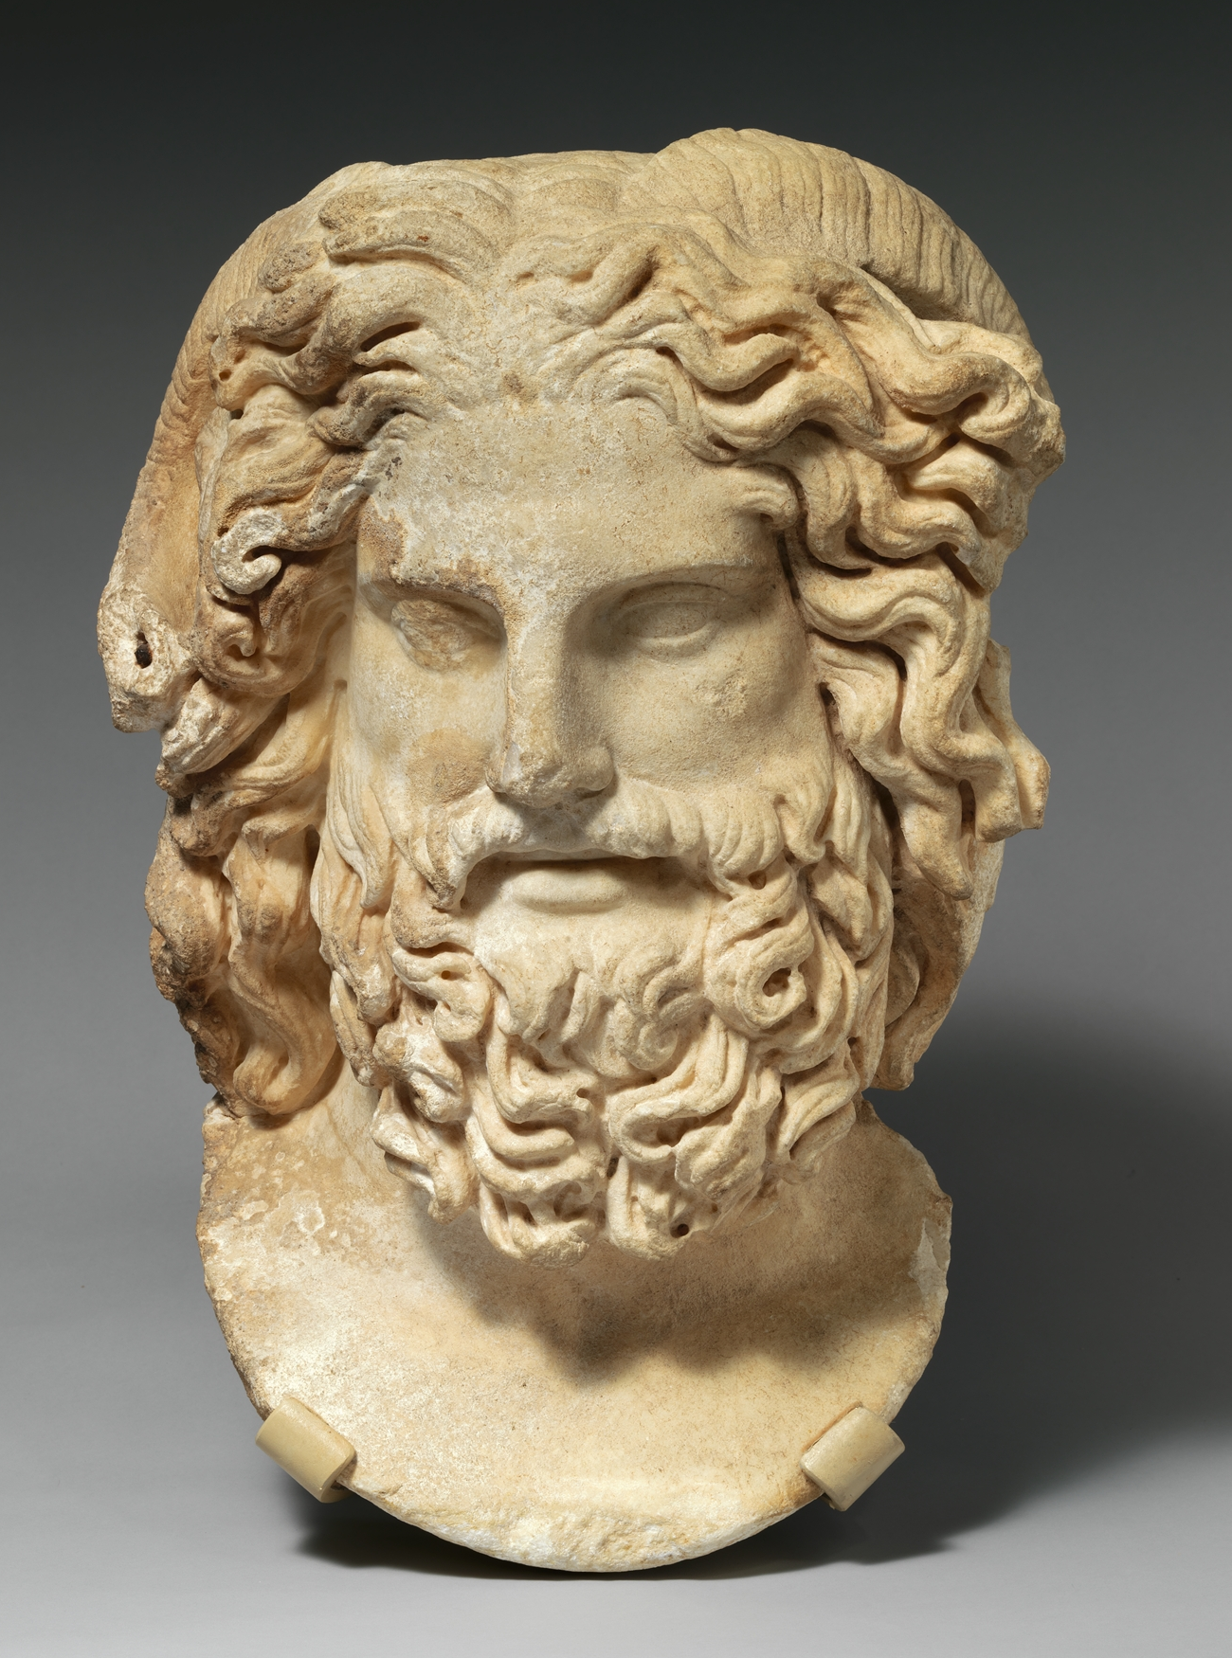

De Bruijn
[de Bruijn 1972]
-- Intrinsically Typed ✅
-- dup = Lambda (Apply (Var Pop) (Var Pop)) -- \x.xx
-- Amenable to Metaprogramming ✅
[Atkey 2009]
-- Unembedding ✅
unembed :: Repr -> STLC ts t
-- Not Ergonomic ❗️❌
tt = Lambda (Lambda (Var (Pop Top))) -- λxy.x / λλ.1
ff = Lambda (Lambda (Var Top)) -- λxy.y / λλ.0
Notes:
The canonical representation of syntax with binding is that of de Bruijn
This first-order representation has a lot of benefits
It can be Intrinsically typed: that is, you can embed a language such that the host language’s type system rules out ill-typed guest terms. For example, an embedding of the Simply typed lambda calc can rule out the duplicator term
Another desirable benefit of embedded languages is metaprogramming: the ability to use the host language to inspect, construct, optimise, and analyse programs of the guest language. With this representation of syntax, the whole AST is accessible without restriction
In fact, this representation is so amendable that the notion of “unembedding”, that is converting to this representation from another, has been established.
Unfortunately, this representation is not ergonomic to use. It is very easy for a user to write the wrong term. For example, the functions tt and ff are easy to mix up
And this is the crux of our quest: we want to find a syntactic representation that has all of these qualities and more!

Slide 4





Contextual Embeddings
Notes:
We present Contextual Embeddings!

Slide 5



Contextual Embeddings
□
unembed
$$⊸$$
Ctx
DB
contextualise
Notes:
Contextual embedding is a technique for embedding languages with binders that
Combines the benefits of a first-order representation with an ergonomic interface,
Even working for Modal and substructural embedded languages, and
Contextual Embeddings are isomorphic to the first-order embedding complete with a type-safe unembedding, something that has alluded the community until now
But why has this alluded the community?
--
Time so far = 2min 5s
(Time for section = 1min 30)

Slide 6

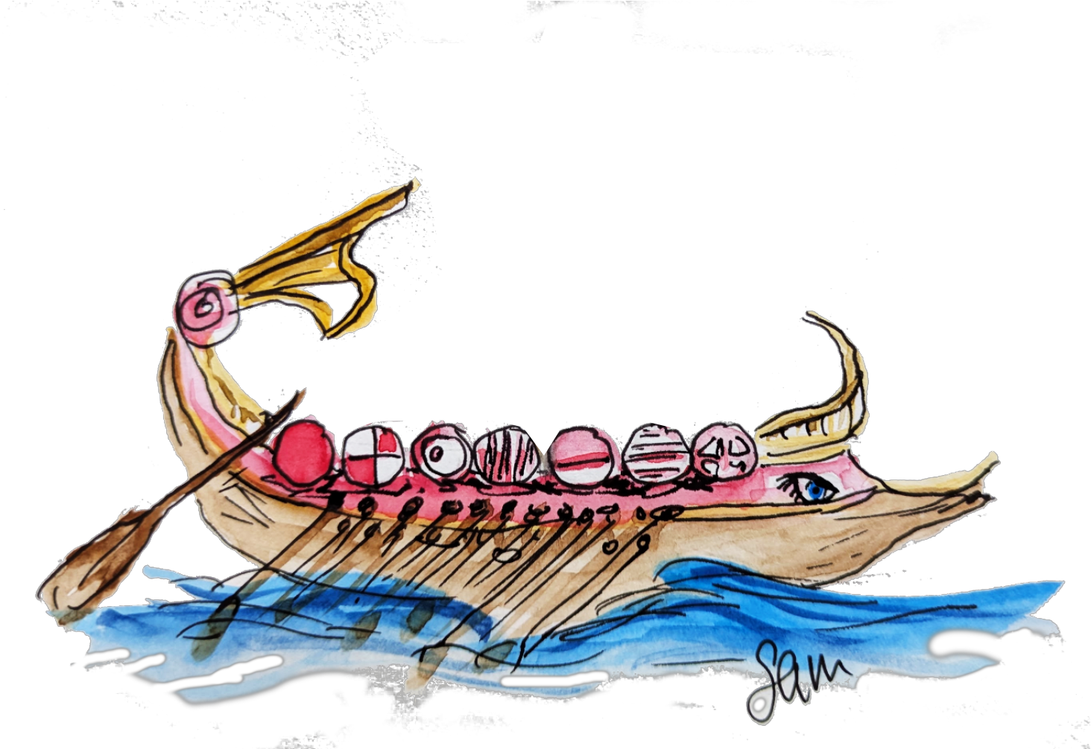

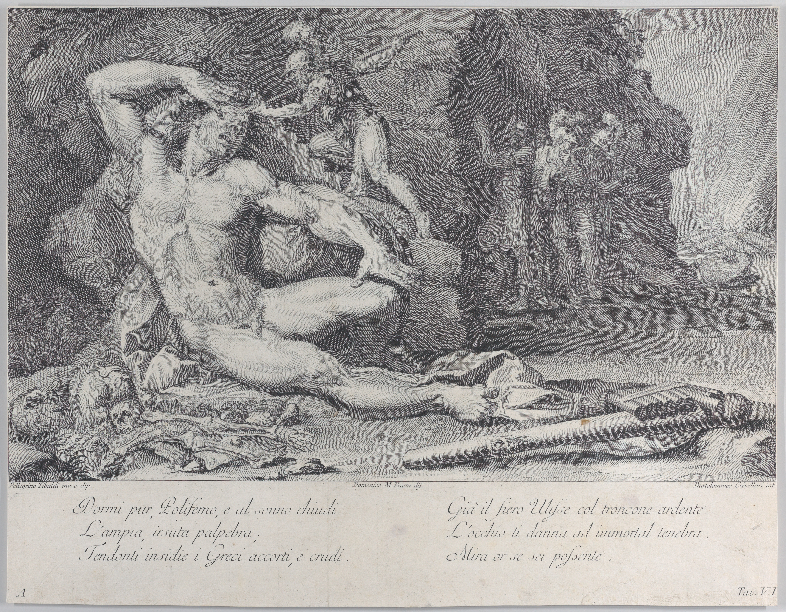
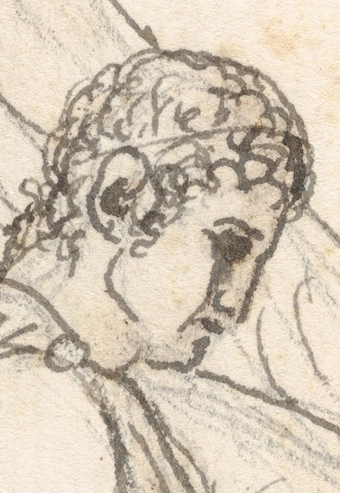

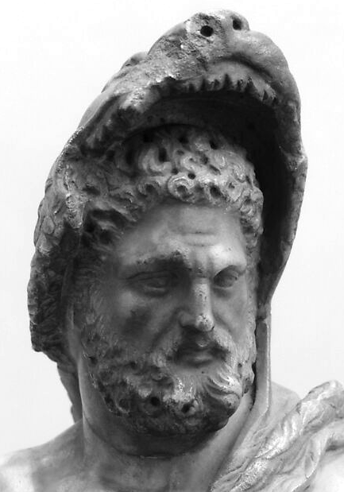
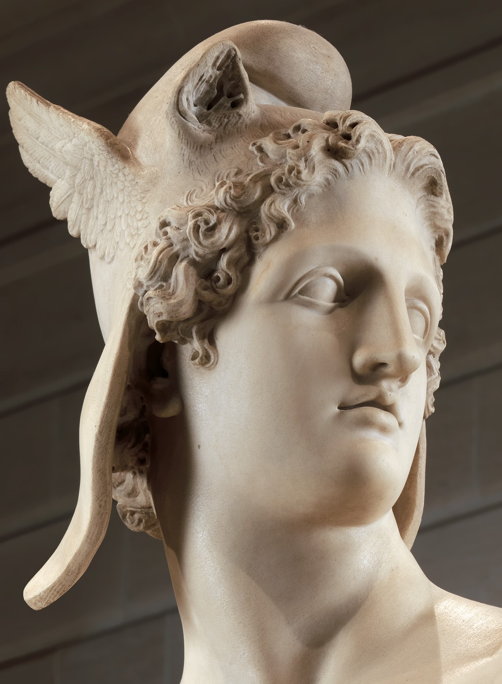
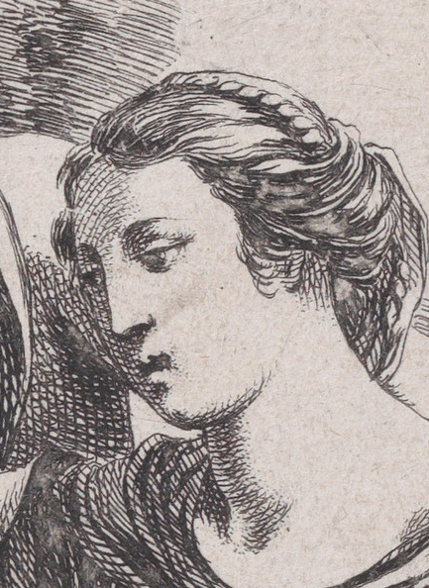
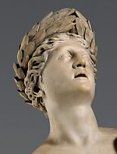
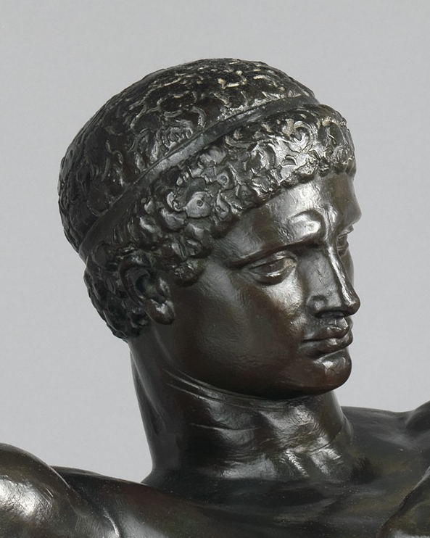
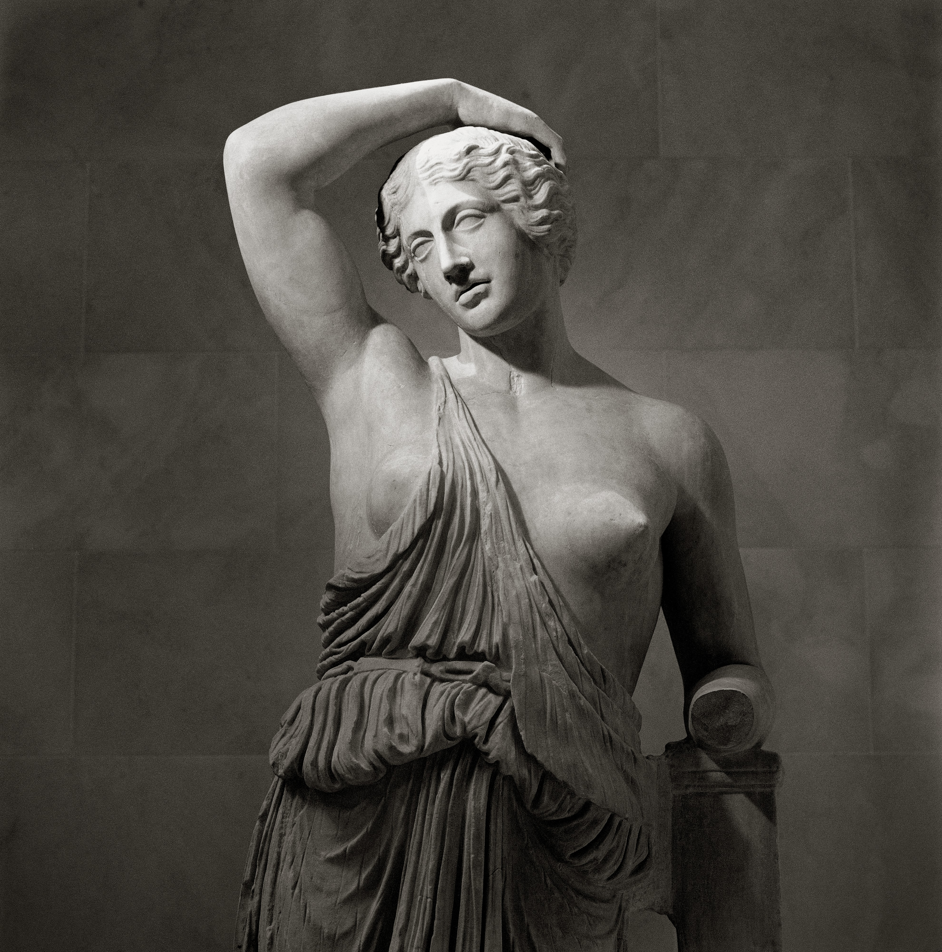
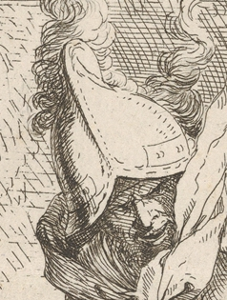
The HOdyASsey
Notes:
Well, we are just one part of heroic “Quest for the Golden Binder Representation”*, or as I like to call it: The HOdyASsey
Allow me bring you up to speed
---
Left to right:
HOAS instigators
Gérard Huet represented by Odysseus
Bernard Lang represented by Achilles
Weak HOAS
Joëlle Despeyroux represented by Atalanta
André Hirschowitz represented by Orpheus
PHOAS
Adam Chlipala represented by Theseus
BGB authors
Geoffrey Washburn represented by Hercules
Stephanie Weirich represented by Hippolyta
Unembedding
Robert Atkey represented by Jason
Sam Lindley represented by Perseus
Jeremy Yallop represented by Bellerophon
---
*yes mythology nerds I am mixing up my Greek mythology references but hey ho, bar this flippant reference to Jason, we will stick to just being loosely based on the Odyssey

Slide 7

Troy
Notes:
Our heroes set sail with the idea of Higher Order Abstract Syntax: HOAS
--
START: Troy / HOAS

Slide 8
HOAS
[Huet and Lang 1978]
data HOAS t where
Lam :: (HOAS a -> HOAS b)
-> HOAS (a :-> b)
App :: HOAS (a :-> b)
-> (HOAS a -> HOAS b)
-- Ergonomic ✅
tt = Lam (\x -> Lam (\y -> x)) -- λxy. x
ff = Lam (\x -> Lam (\y -> y)) -- λxy. y
Notes:
Here is the STLC represented using HOAS
HOAS represents guest binders with host binders. Notice how lam takes a host function as its argument and the lack of a var constructor
This allows us to write guest terms ergonomically, utilizing the host’s existing binder infrastructure
This is easy for both users and implementors alike

Slide 9
Notes:
Our heroes …

Slide 10
Notes:
…will encounter a number of problems on their journey

Slide 12
The Plundering of Ismarus
-- Compatible with Type Theory ❗️❌
        data HOAS t where
        Lam :: (HOAS a -> HOAS b) -> HOAS (a :-> b)
        App :: HOAS (a :-> b) -> HOAS a -> HOAS b
Notes:
The first of which was a lack of decorum – our heroes need to formalize their syntax in a theorem prover
Alas, theorem provers only support strictly positive types
This means that our HOAS representation would be rejected due to the negative occurrence of HOAS, highlighted here in yellow
Fear not tho …
--
2: Ismarus (plundering) / weakHOAS

Slide 13
Weak HOAS
[Despeyroux and Hirschowitz 1994]
data Var (a :: Ty) = Var String
data WeakHOAS a where
Var :: Var a -> WeakHOAS a
Lam :: (Var a -> WeakHOAS b)
-> WeakHOAS (a :-> b)
-- Compatible with
-- Type Theory ✅
App :: WeakHOAS (a :-> b)
-> WeakHOAS a -> WeakHOAS b
Notes:
…our heroes Despeyroux and Hirschowitz stepped up to save our quest
Their solution, weakHOAS, is to have a separate type for variables: Var
Now, where formerly there was a negative occurrence of the type we are defining, we just have a separate type, which is accepted by theorem provers!

Slide 14
Notes:
Next…

Slide 15
Notes:
our heroes were blown wildly off course…

Slide 16
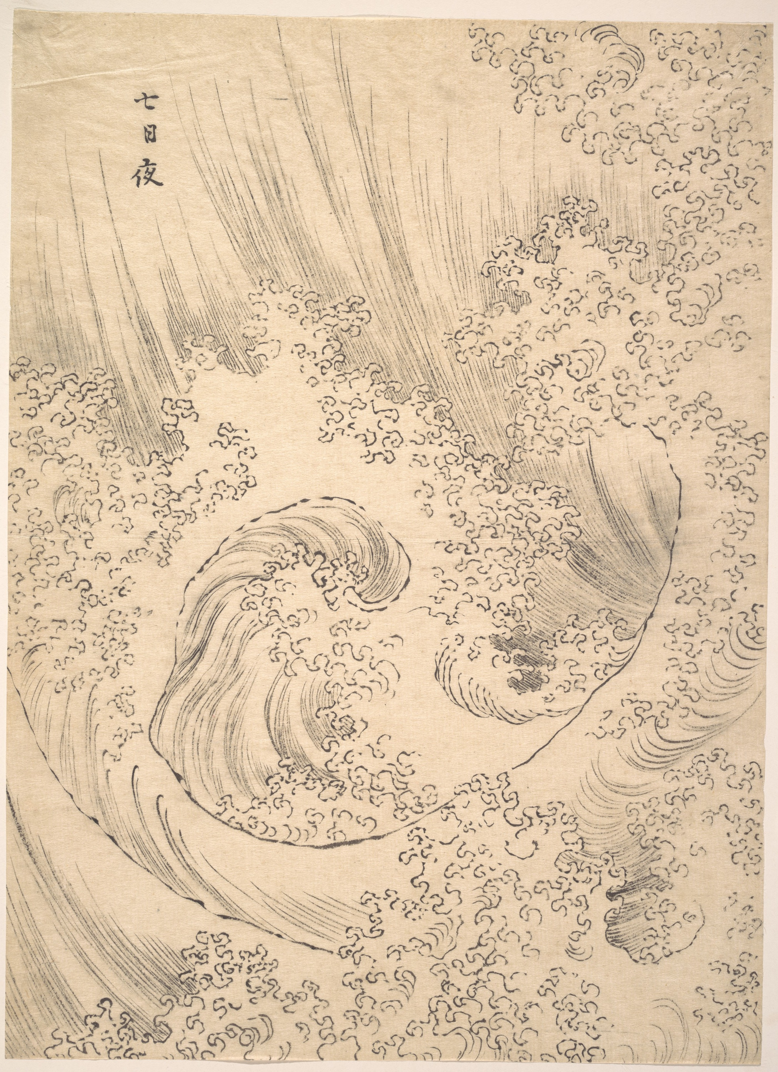

Slide 17
Sirens
-- Excludes Exotic ❗️❌
      exotic = Lam (\x -> case x of
                Var “a” -> tt
                Var “b” -> ff)
Notes:
…blown all the way to their next encounter: the seductive sirens of exotic terms
An exotic term is a term of an embedded language that does not correspond to an expressible term of the guest language. For example, here because our host, Haskell, supports pattern matching, we can branch based on the name of a variable, something that is not expressible in the STLC
---
3-12: lots: Sirens and Circe

Slide 18
PHOAS
[Chlipala 2008]
data WeakHOAS v a where
Var :: v a -> WeakHOAS v a
Lam :: (v a -> WeakHOAS v b)
-> WeakHOAS v (a :-> b)
App :: WeakHOAS v (a :-> b)
-> WeakHOAS v a -> WeakHOAS v b
type PHOAS = forall v. WeakHOAS v
BGB
Sirens
[Washburn and Weirich 2008]
-- Excludes Exotic ✅
-- exotic :: PHOAS v (a :-> b)
-- exotic = Lam (\x -> case x of
-- cannot match on abstract type
-- Var “a” -> tt
-- Var “b” -> ff)
Notes:
Luckily, Chlipala marshalled the different talents of his companions, combining weakHOAS with ideas from Washburn and Weirich harnessing the power of parametric polymorphism to banish exotic terms, creating PHOAS
They key development here is to be parametric over v
This excludes exotic terms, because you cannot match on an abstract type like v
--
Adam Chlipala represented by Theseus

Slide 19
Circe
-- Supports “Super-fold” Semantics ❗️❌
        optBGB :: BGB a -> BGB a
        optBGB = cata ???
Notes:
In fact, this combination kills two birds with one stone:
Washburn and Weirich present cata, effectively a fold, as a convenient elimination form for HOAS terms
This is a useful development until you want to perform operations that require more than one traversal of the syntax, that is, until you require "super-fold" semantics, as we encounter with our next challenge
Consider writing an optimization function for your embedded syntax. Operations like this require more than one traversal of the syntax because performing one optimization might reveal opportunities for further optimization, opportunities that will be lost if you only traverse the syntax tree once. So, cata won’t cut it here
Luckily, for us, a clever choice of v with our PHOAS representation allows us to unembed to our first order representation
---
Forall Tagless can be considered similar to BGB, with the fold semantics being directly applied to this shallow embedding. The forall prevents exotic terms, and like BGB we are limited to fold semantics.
It is Alex’s belief that tagless cannot be HOAS because it is a shallow embedding, he asserts that only deep embeddings are truly HOAS (cos is shallow really syntax?)

Slide 20
PHOAS
[Chlipala 2008]
data WeakHOAS v a where
Var :: v a -> WeakHOAS v a
Lam :: (v a -> WeakHOAS v b)
-> WeakHOAS v (a :-> b)
App :: WeakHOAS v (a :-> b)
-> WeakHOAS v a -> WeakHOAS v b
type PHOAS = forall v. WeakHOAS v
Circe
unembed :: WeakHOAS (DB.Index ts) t
-> DB.STLC ts t
optPHOAS :: PHOAS t -> DB.STLC ts t
optPHOAS = optDB . unembed
Notes:
Unembedding into the first order representation grants us its amenability, allowing us to reuse existing de bruijn optimisations, which can perform our desired optimisations because they are not limited to one traversal of syntax

Slide 21
Notes:
Alas…

Slide 22
Notes:
there are still issues here, our quest is not over…

Slide 23
-- Back Again❗️❌
transmit :: PHOAS t -> PHOAS t
transmit = ??? . marshal . unembed
Calypso
Notes:
Our heroes are now stranded on the Isle of Calypso, with their on-board computer lost
So, they need to transmit their code for execution elsewhere
Unembedding allows them to remove the host closures from the code, making it transmittable, but there is not way to convert it back on the other side!
Thus they need a way to un-unembed
---
13: Calypso / unembedding (quest stranded for 10 / 8 years)
Adam’s well-formedness work is 2011 / 2013, so predates us, but comes after this

Slide 24
Unembedding
[Atkey, Lindley and Yallop 2009]
data WeakHOAS v a where
Var :: v a -> WeakHOAS v a
Lam :: (v a -> WeakHOAS v b)
-> WeakHOAS v (a :-> b)
App :: WeakHOAS v (a :-> b)
-> WeakHOAS v a -> WeakHOAS v b
type PHOAS = forall v. WeakHOAS v
Calypso
unembed :: WeakHOAS (DB.Index ts) t -> DB.STLC ts t
toPHOAS :: DB.STLC ts t -> PHOAS t
transmit :: PHOAS t -> PHOAS t
transmit = toPHOAS . marshal . unembed
Notes:
This time, Atkey et al save the day by proving the first-order and higher-order representations to be isomorphic
They use this proof to justify an implementation of this isomorphism: providing us the desired there and back again functions
---
toPHOAS = toPHOAS’ TEmpty
toPHOAS’ :: TEnv PHOAS ts -> DB.STLC ts t -> PHOAS t

Slide 25
-- Type Safe Unembedding❗️❌
unembed :: PHOAS (DB.Index ts) t -> (DB.STLC ts t)
unembed (Var v) = (DB.Var v)
unembed (App e1 e2)
= DB.Apply (unembed e1) (unembed e2)
unembed (Lam f)
= DB.Lambda (unembed (unsafeCoerce $
f (unsafeCoerce $ DB.Top)))
Calypso
😱
😱
Notes:
However, all current implementations of unembed rely on external justifications like Atkey’s proof to implement them using unsafe operations like these unsafeCoerces shown here
And that is where our heroes’ journey ends. Stranded with this unsatisfying reliance on external justifications
---
TLDR:
PHOAS needs to assert an axiom for its closure conversion
Unembedding uses atkeys proof to justify unsafe operations
Paper extract for precision:
Current implementations [Atkey et al. 2009; Keuchel and Jeuring 2012; Matsuda, Frohlich, et al. 2023; McDonell et al. 2013] rely on externally justified operations (fromJust, postulate, unsafeCoerce, and a dynamic lookup, respectively) whose safety cannot be verified by the host language’s type system. Atkey [2009] dedicates a whole paper
to this proof, which is reused / adapted carefully by Matsuda, Frohlich, et al. [2023], McDonell et al.
[2013], and Keuchel and Jeuring [2012]. Chlipala [2008, §3.1] encounters a similar problem in the
setting of theorem provers with his work on Parametric Higher-Order Abstract Syntax (PHOAS):
he finds it necessary to assert an additional axiom—an instance of internal parametricity—which is
not readily available in current theorem provers.

Slide 26

Calypso
Embedding by Unembedding
[Matsuda, Frohlich, Wang and Wu 2023]
Notes:
17 years have now passed … and this is where I come in
Our ICFP23 paper, Embedding by Unembedding realises the full potential of unembedding, showing it to be invaluable when defining languages with interesting semantics, such as those in bidirectional or incremental domains
But it still relies upon those external proofs…
--
Time so far = 7min 5s
(Time for section = 5mins)

Slide 27
Notes:
And that brings us right up to now …

Slide 28
PHOeASians
Notes:
…with me telling you this story, and the elusive type-safe unembedding still at large
Host languages have developed and become more powerful in the past 17 years
So motivated by this and working on the Embedding by Unembedding paper, I thought it was time again to pick up the quest for the golden binder representation!
---
14: Contextual embedding / Phaeacians (O tells his story, this brings us to now with me telling this story :D)

Slide 29
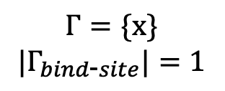
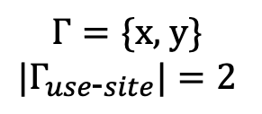
Contextual Embeddings
Development of type class instance resolution
The observation that:
$$de Bruijn Index =\left|Γ_{use\text{−}site}\right|−|Γ_{bind\text{−}site}|$$
$$1= 2 − 1$$
\. -> \. -> 1
\x -> \y -> x
-- De Bruijn
-- Named
$$Γ=\text{\{}\text{x}\text{\}}$$
$${|Γ}_{bind\text{−}site}|=1$$
$$Γ=\text{\{}\text{x}\text{, }\text{y}\text{\}}$$
$${|Γ}_{use\text{−}site}|=2$$
Notes:
Resulting in Contextual Embeddings, complete with type-safe unembedding, an ergonomic interface and more!
The secret to our success?
Well,
Type-level programming of host languages is much more powerful today, in particular, type class instance resolution has become more expressive.
We combined this with the observation that: the difference in size between the bind-site context and the use-site context of a variable is exactly its de Bruijn index
Let me show you a quick example.
Here is the const function.
For the variable x,
At bind site, the context only contains 1 variable: x
At use site, the context has grown to size 2 to include y
I’m sure you need no convincing that 2-1 is 1, the correct de bruijn index as desired
Now, lets dig into the details of Contextual Embeddings
--
Time so far = 8min 25s
(Time for section = 1min 15 )
HOW
Observation: The difference in size between the bind site context and the use site context is exactly the de Bruijn index – levels vs DB
Precise: The host’s type class instance resolution mechanism can be used to automatically calculate the correct de Bruijn index when the context is maintained and accessible in the term’s type using the following observation: The difference in size between the binding site context and the use site context is exactly the de Bruijn index

Slide 30
De Bruijn
[de Bruijn 1972]
-- STLC:
data Ty = Unit | Ty :-> Ty -- Guest types
data Ctx = Empty | Ctx :/: Ty -- Typing context
-- Index into typing context
data Index :: Ctx -> Ty -> Type where
Top :: Index (ts :/: t) t
Pop :: Index ts t -> Index (ts :/: t’) t
-- Syntax:
data STLC :: Ctx -> Ty -> Type where
Var :: Index ts t -> STLC ts t -- Variables
Lambda :: STLC (ts :/: t1) t2 -> STLC ts (t1 :-> t2) -- Abstraction
Apply :: STLC ts (t1 :-> t2) -> STLC ts t1 -> STLC ts t2 -- Application
-- Natural Numbers
data Nat where
  Z :: Nat
  S :: Nat -> Nat
Notes:
Where previous approaches start from HOAS, we will preserve the context, so that we can use our observation, and start from DB representation to construct our solution
Here is an embedding of STLC in Haskell, using the de bruijn first-order representation, where we have taken care to ensure that it is intrinsically typed
We define guest types and the typing context as normal Haskell data types, with the plan of lifting these to the type level
Our guest types, the types of the STLC, can either be unit, or function types
The typing context is a snocced list of guest types
For the de bruijn indices, to ensure the intrinsic typing, we enrich the standard natural numbers representation with type information to ensure that the indices actually refer to a type in the context
These enriched be bruijn indices are parameterised by the typing context and the type of interest
Top indicates that the type we are referring to, t, is at the top of the context
Pop indicates that the type we are referring to is deeper: here, t' is not who we are looking for, so we pop them off, and continue looking for t in ts
These pieces come together to define our syntax
Guest terms are also parametrised by a typing context and the type of the guest term
Vars use the DB index
Lambda abstracts over a body term in an extended context (ts :/: t1) to introduce a function term of type (t1 :-> t2), and
Application is what you would expect
---
DB is represented by zeus

Slide 31
Contextual Embeddings
data Ty = Unit | Ty :-> Ty -- Guest types
data Ctx = Empty | Ctx :/: Ty -- Typing context
data Index :: Ctx -> Ty -> Type where -- Index into typing context
Top :: Index (ts :/: t) t
Pop :: Index ts t -> Index (ts :/: t’) t
data STLC :: Ctx -> Ty -> Type where
Var :: Index ts t -> STLC ts t -- Variables
Lambda :: STLC (ts :/: t1) t2
-> STLC ts (t1 :-> t2) -- Abstraction
Apply :: STLC ts (t1 :-> t2) -> STLC ts t1 -> STLC ts t2 -- Application
Notes:
Starting from this DB rep, we…
---
PLDI: please use a contextual embedding (must understand unembedding, cos that’s the main selling point)
Contextual embeddings are great for when you want control over the binders, but hoas niceties
Gains – linear/modal types, all the eval usability stuff
WHAT CE is and WHY/WHEN they would wanna use it
Technique is agnostic to type setting hence works in linear etc

Slide 32
Contextual Embeddings
data Ty = Unit | Ty :-> Ty -- Guest types
data Ctx = Empty | Ctx :/: Ty -- Typing context
data Index :: Ctx -> Ty -> Type where -- Index into typing context
Top :: Index (ts :/: t) t
Pop :: Index ts t -> Index (ts :/: t’) t
data STLC :: Ctx -> Ty -> Type where
Var :: Index ts t -> STLC ts t -- Variables
Lambda :: (Index (ts :/: t1) t1 -> STLC (ts :/: t1) t2)
-> STLC ts (t1 :-> t2) -- Abstraction
Apply :: STLC ts (t1 :-> t2) -> STLC ts t1 -> STLC ts t2 -- Application
-- Excludes exotic❗️❌
exotic = NLam $ \x -> case x of { Top -> tt ; Pop _ -> ff }
Notes:
…change lambda to use a host function because that is great for ergonomics
Of course, as we learnt from the HOdASsey, this introduces an exotic term, cos now you can match on the index

Slide 33
Contextual Embeddings
data Ty = Unit | Ty :-> Ty -- Guest types
data Ctx = Empty | Ctx :/: Ty -- Typing context
data Index :: Ctx -> Ty -> Type where -- Index into typing context
Top :: Index (ts :/: t) t
Pop :: Index ts t -> Index (ts :/: t’) t
data STLC :: Ctx -> Ty -> Type where
Var :: ProxyTop ts t -> STLC ts t -- Variables
Lambda :: (ProxyTop (ts :/: t1) t1 -> STLC (ts :/: t1) t2)
-> STLC ts (t1 :-> t2) -- Abstraction
Apply :: STLC ts (t1 :-> t2) -> STLC ts t1 -> STLC ts t2 -- Application
-- Excludes exotic ✅
data ProxyTop :: Ctx -> Ty -> Type where
ProxyTop :: ProxyTop (ts :/: t) t
Notes:
To fix this, we replace index with a truncated index type called ProxyTop, which is just the index type with only the Top constructor
Because there is only one constructor, there is nothing to branch on, preventing exotic terms
It is useful to think of the value of type ProxyTop as a capability—a piece of data that gives us to access the most recently bound variable of type t

Slide 34
Contextual Embeddings
data Ty = Unit | Ty :-> Ty -- Guest types
data Ctx = Empty | Ctx :/: Ty -- Typing context
data Index :: Ctx -> Ty -> Type where -- Index into typing context
Top :: Index (ts :/: t) t
Pop :: Index ts t -> Index (ts :/: t’) t
data ProxyTop :: Ctx -> Ty -> Type where
ProxyTop :: ProxyTop (ts :/: t) t
data STLC :: Ctx -> Ty -> Type where
Var :: ProxyTop ts t -> STLC ts t -- Variables
Lambda :: (ProxyTop (ts :/: t1) t1 -> STLC (ts :/: t1) t2)
-> STLC ts (t1 :-> t2) -- Abstraction
Apply :: STLC ts (t1 :-> t2) -> STLC ts t1 -> STLC ts t2 -- Application
Notes:
But now how do we access previously bound variables?

Slide 35
Contextual Embeddings
Lam' (\x -> Lam' (\y -> Var' (Step Refl) x))
data Ty = Unit | Ty :-> Ty -- Guest types
data Ctx = Empty | Ctx :/: Ty -- Typing context
data Index :: Ctx -> Ty -> Type where -- Index into typing context
Top :: Index (ts :/: t) t
Pop :: Index ts t -> Index (ts :/: t’) t
data ProxyTop :: Ctx -> Ty -> Type where
ProxyTop :: ProxyTop (ts :/: t) t
data STLC :: Ctx -> Ty -> Type where
Var :: ReifyIndexE ts ts2 -> ProxyTop ts t -> STLC ts2 t -- Variables
Lambda :: (ProxyTop (ts :/: t1) t1 -> STLC (ts :/: t1) t2)
-> STLC ts (t1 :-> t2) -- Abstraction
Apply :: STLC ts (t1 :-> t2) -> STLC ts t1 -> STLC ts t2 -- Application
data ReifyIndexE :: Ctx -> Ctx -> Type where
Refl :: ReifyIndexE ts ts
Step :: ReifyIndexE xs ys
      -> ReifyIndexE xs (ys :/: y)
reify :: ReifyIndexE ts ts2
-> ProxyTop ts t
-> Index ts2 t
Notes:
To access all previously bound variables, not just the most recent, we introduce a type ReifyIndexE
This type is evidence that ts2 is an extension of the context ts
This, and our observation about bind and use site contexts can guide a function reify to turn a (ProxyTop ts t) into an (Index ts2 t )
However, DB indices are back!
Providing ReifyIndexE is just the same as providing the DB index
Fear not tho! This is where we can make use of the host’s instance resolution to construct this value for us!

Slide 36
Contextual Embeddings
{-# LANGUAGE UndecidableInstances #-}
class ReifyIndex ts ts2 where
reify :: ProxyTop ts t -> Index ts2 t
-- Corresponds to Refl
instance {-# OVERLAPPING #-} ReifyIndex ts ts where
reify ProxyTop = Top
-- Corresponds to Step
instance (ReifyIndex ts ts2, ts3 ~ (ts2 :/: a))
  => ReifyIndex ts ts3 where
    reify i = Pop (reify i)
Notes:
By swapping ReifyIndexE out for a type class with a reify method, we can remove the user’s need to provide this evidence, as this can be done automatically with the following instances:
The first instance, which corresponds to the Refl constructor of ReifyIndexE, where both typing contexts are the same offers a straight-forward conversion from ProxyTop to Top
The second instance, which corresponds to the Step constructor is a little more involved…

Slide 37
Contextual Embeddings
{-# LANGUAGE UndecidableInstances #-}
class ReifyIndex ts ts2 where
reify :: ProxyTop ts t -> Index ts2 t
-- Corresponds to Refl
instance {-# OVERLAPPING #-} ReifyIndex ts ts where
reify ProxyTop = Top
-- Corresponds to Step
instance (ReifyIndex ts ts2, ts3 ~ (ts2 :/: a))
  => ReifyIndex ts ts3 where
    reify i = Pop (reify i)
Notes:
It says, to evidence that…

Slide 38
Contextual Embeddings
{-# LANGUAGE UndecidableInstances #-}
class ReifyIndex ts ts2 where
reify :: ProxyTop ts t -> Index ts2 t
-- Corresponds to Refl
instance {-# OVERLAPPING #-} ReifyIndex ts ts where
reify ProxyTop = Top
-- Corresponds to Step
instance (ReifyIndex ts ts2, ts3 ~ (ts2 :/: a))
  => ReifyIndex ts ts3 where
    reify i = Pop (reify i)
Notes:
ts3 is an extension of ts, we require that …

Slide 39
Contextual Embeddings
{-# LANGUAGE UndecidableInstances #-}
class ReifyIndex ts ts2 where
reify :: ProxyTop ts t -> Index ts2 t
-- Corresponds to Refl
instance {-# OVERLAPPING #-} ReifyIndex ts ts where
reify ProxyTop = Top
-- Corresponds to Step
instance (ReifyIndex ts ts2, ts3 ~ (ts2 :/: a))
  => ReifyIndex ts ts3 where
    reify i = Pop (reify i)
Notes:
some ts2 is an extension of ts

Slide 40
Contextual Embeddings
{-# LANGUAGE UndecidableInstances #-}
class ReifyIndex ts ts2 where
reify :: ProxyTop ts t -> Index ts2 t
-- Corresponds to Refl
instance {-# OVERLAPPING #-} ReifyIndex ts ts where
reify ProxyTop = Top
-- Corresponds to Step
instance (ReifyIndex ts ts2, ts3 ~ (ts2 :/: a))
  => ReifyIndex ts ts3 where
    reify i = Pop (reify i)
Notes:
and that ts3 is this exactly ts2 extended by one more type, a.

Slide 41
Contextual Embeddings
{-# LANGUAGE UndecidableInstances #-}
class ReifyIndex ts ts2 where
reify :: ProxyTop ts t -> Index ts2 t
-- Corresponds to Refl
instance {-# OVERLAPPING #-} ReifyIndex ts ts where
reify ProxyTop = Top
-- Corresponds to Step
instance (ReifyIndex ts ts2, ts3 ~ (ts2 :/: a))
  => ReifyIndex ts ts3 where
    reify i = Pop (reify i)
Notes:
Reify is then recursively defined, with the highlighted constraint asserting that the recursive call exists

Slide 42
Contextual Embeddings
{-# LANGUAGE UndecidableInstances #-}
class ReifyIndex ts ts2 where
reify :: ProxyTop ts t -> Index ts2 t
-- Corresponds to Refl
instance {-# OVERLAPPING #-} ReifyIndex ts ts where
reify ProxyTop = Top
-- Corresponds to Step
instance (ReifyIndex ts ts2, ts3 ~ (ts2 :/: a))
  => ReifyIndex ts ts3 where
    reify i = Pop (reify i)
Notes:
Then to account for for the final difference, the addition of a, we add a Pop

Slide 43
Contextual Embeddings
{-# LANGUAGE UndecidableInstances #-}
class ReifyIndex ts ts2 where
reify :: ProxyTop ts t -> Index ts2 t
-- Corresponds to Refl
instance {-# OVERLAPPING #-} ReifyIndex ts ts where
reify ProxyTop = Top
-- Corresponds to Step
instance (ReifyIndex ts ts2, ts3 ~ (ts2 :/: a))
  => ReifyIndex ts ts3 where
    reify i = Pop (reify i)
Notes:
Essentially, we are counting the difference between the bind-site and use-site contexts to produce the correct de bruijn index
---
These instances push haskell’s type class system to its limits, but we have taken care to ensure that their resolution is deterministic and terminating*
*If someone does ask about Undecidable:
Haskell’s instance solving mechanism requires that instances be picked unambiguously. This is not the case here: when ts2 is any non-empty list both instances match, and none is more specific than the other. One could force Haskell to accept that by using the (now deprecated) IncoherentInstances extension. However, this has the potential to cause unpredictable behaviour. Instead, we add an equality constraint ts2 ~ (ts1 :/: t’) to the second instance. Now the ‘reflexive’ case is treated as more specific than the ‘step’ case—as its parameters are syntactically equal. This does not solve the original problem: the cases are still overlapping. However, we can use the OVERLAPPING pragmas to signal which one should take precedence—in our case, reflexivity. To make this code type-check we have to enable the UndecidableInstances extension. This is required because the step case is recursive. However, the recursion is structural, so this step will not create loops.

Slide 44
Contextual Embeddings
data Ty = Unit | Ty :-> Ty -- Guest types
data Ctx = Empty | Ctx :/: Ty -- Typing context
data Index :: Ctx -> Ty -> Type where -- Index into typing context
Top :: Index (ts :/: t) t
Pop :: Index ts t -> Index (ts :/: t’) t
data ProxyTop :: Ctx -> Ty -> Type where
ProxyTop :: ProxyTop (ts :/: t) t
data STLC :: Ctx -> Ty -> Type where
Var :: ReifyIndex ts ts2 => ProxyTop ts t -> STLC ts2 t -- Variables
Lambda :: (ProxyTop (ts :/: t1) t1 -> STLC (ts :/: t1) t2)
-> STLC ts (t1 :-> t2) -- Abstraction
Apply :: STLC ts (t1 :-> t2) -> STLC ts t1 -> STLC ts t2 -- Application
class ReifyIndex ts ts2 where
reify :: ProxyTop ts t -> Index ts2 t
instance (ReifyIndex ts ts2, ReifyIndex' ~ (ts2 :/: a))
  => ReifyIndex ts ts3 where
    reify i = Pop (reify i)
instance {-# OVERLAPPING #-} ReifyIndex ts ts where
reify ProxyTop = Top
Notes:
Voila, here is the full system, notice how ReifyIndexE has been replaced with a type class constraint

Slide 45
Contextual Embeddings
data Ty = Unit | Ty :-> Ty -- Guest types
data Ctx = Empty | Ctx :/: Ty -- Typing context
data Index :: Ctx -> Ty -> Type where -- Index into typing context
Top :: Index (ts :/: t) t
Pop :: Index ts t -> Index (ts :/: t’) t
data ProxyTop :: Ctx -> Ty -> Type where
ProxyTop :: ProxyTop (ts :/: t) t
data STLC :: Ctx -> Ty -> Type where
Var :: ReifyIndex ts ts2 => ProxyTop ts t -> STLC ts2 t -- Variables
Lambda :: (ProxyTop (ts :/: t1) t1 -> STLC (ts :/: t1) t2)
-> STLC ts (t1 :-> t2) -- Abstraction
Apply :: STLC ts (t1 :-> t2) -> STLC ts t1 -> STLC ts t2 -- Application
class ReifyIndex ts ts2 where
reify :: ProxyTop ts t -> Index ts2 t
instance (ReifyIndex ts ts2, ReifyIndex' ~ (ts2 :/: a))
  => ReifyIndex ts ts3 where
    reify i = Pop (reify i)
instance {-# OVERLAPPING #-} ReifyIndex ts ts where
reify ProxyTop = Top
Notes:
And it all, just about, fits on one slide!
Let’s review the key points

Slide 46
Contextual Embeddings
data Ty = Unit | Ty :-> Ty -- Guest types
data Ctx = Empty | Ctx :/: Ty -- Typing context
data Index :: Ctx -> Ty -> Type where -- Index into typing context
Top :: Index (ts :/: t) t
Pop :: Index ts t -> Index (ts :/: t’) t
data ProxyTop :: Ctx -> Ty -> Type where
ProxyTop :: ProxyTop (ts :/: t) t
data STLC :: Ctx -> Ty -> Type where
Var :: ReifyIndex ts ts2 => ProxyTop ts t -> STLC ts2 t -- Variables
Lambda :: (ProxyTop (ts :/: t1) t1 -> STLC (ts :/: t1) t2)
-> STLC ts (t1 :-> t2) -- Abstraction
Apply :: STLC ts (t1 :-> t2) -> STLC ts t1 -> STLC ts t2 -- Application
tt = Lambda (\x -> Lambda (\y -> Var x))
ff = Lambda (\x -> Lambda (\y -> Var y))
class ReifyIndex ts ts2 where
reify :: ProxyTop ts t -> Index ts2 t
instance (ReifyIndex ts ts2, ReifyIndex' ~ (ts2 :/: a))
  => ReifyIndex ts ts3 where
    reify i = Pop (reify i)
instance {-# OVERLAPPING #-} ReifyIndex ts ts where
reify ProxyTop = Top
Notes:
By using host functions, we have achieved the same ergonomics as HOAS

Slide 47
Contextual Embeddings
data Ty = Unit | Ty :-> Ty -- Guest types
data Ctx = Empty | Ctx :/: Ty -- Typing context
data Index :: Ctx -> Ty -> Type where -- Index into typing context
Top :: Index (ts :/: t) t
Pop :: Index ts t -> Index (ts :/: t’) t
data ProxyTop :: Ctx -> Ty -> Type where
ProxyTop :: ProxyTop (ts :/: t) t
data STLC :: Ctx -> Ty -> Type where
Var :: ReifyIndex ts ts2 => ProxyTop ts t -> STLC ts2 t -- Variables
Lambda :: (ProxyTop (ts :/: t1) t1 -> STLC (ts :/: t1) t2)
-> STLC ts (t1 :-> t2) -- Abstraction
Apply :: STLC ts (t1 :-> t2) -> STLC ts t1 -> STLC ts t2 -- Application
tt = Lambda (\(x :: ProxyTop (ts :/: a) a) ->
Lambda (\(y :: ProxyTop (ts :/: a :/: b) b) -> Var x))
class ReifyIndex ts ts2 where
reify :: ProxyTop ts t -> Index ts2 t
instance (ReifyIndex ts ts2, ReifyIndex' ~ (ts2 :/: a))
  => ReifyIndex ts ts3 where
    reify i = Pop (reify i)
instance {-# OVERLAPPING #-} ReifyIndex ts ts where
reify ProxyTop = Top
Notes:
The singleton ProxyTop allows us to snapshot the context at the variable’s bind-site

Slide 48
Contextual Embeddings
data Ty = Unit | Ty :-> Ty -- Guest types
data Ctx = Empty | Ctx :/: Ty -- Typing context
data Index :: Ctx -> Ty -> Type where -- Index into typing context
Top :: Index (ts :/: t) t
Pop :: Index ts t -> Index (ts :/: t’) t
data ProxyTop :: Ctx -> Ty -> Type where
ProxyTop :: ProxyTop (ts :/: t) t
data STLC :: Ctx -> Ty -> Type where
Var :: ReifyIndex ts ts2 => ProxyTop ts t -> STLC ts2 t -- Variables
Lambda :: (ProxyTop (ts :/: t1) t1 -> STLC (ts :/: t1) t2)
-> STLC ts (t1 :-> t2) -- Abstraction
Apply :: STLC ts (t1 :-> t2) -> STLC ts t1 -> STLC ts t2 -- Application
class ReifyIndex ts ts2 where
reify :: ProxyTop ts t -> Index ts2 t
instance ( ReifyIndex ts ts2
, ReifyIndex' ~ (ts2 :/: a))
  => ReifyIndex ts ts3 where
    reify i = Pop (reify i)
instance {-# OVERLAPPING #-} ReifyIndex ts ts where
reify ProxyTop = Top
Notes:
This gives us enough information to calculate the correct de bruijn index at use site automatically by using the host’s type class system
--
Time so far = 12min 55s
(time for section = 4min 30)

Slide 49
Contextual Embeddings
-- Intrinsically Typed ✅
-- dup = Lambda (\x -> (Apply (Var x) (Var x))) -- \x.xx
Notes:
Let’s review Contextual Embeddings against the criteria we have gathered over our journey
Firstly, they are intrinsically typed: the host’s type system will reject ill-typed guest terms like dup
---

Slide 50
Contextual Embeddings
-- Intrinsically Typed ✅
-- Ergonomic ✅
tt = Lambda (\x -> Lambda (\y -> Var x))) -- λxy. x
ff = Lambda (\x -> Lambda (\y -> Var y)) -- λxy. y
Notes:
Our use of host functions makes guest binders ergonomic

Slide 51
Contextual Embeddings
-- Intrinsically Typed ✅
-- Ergonomic ✅
-- Compatible with Type Theory ✅
data STLC :: Ctx -> Ty -> Type where
Var :: ReifyIndex ts ts2 => ProxyTop ts t -> STLC ts2 t -- Variables
Lambda :: (ProxyTop (ts :/: t1) t1 -> STLC (ts :/: t1) t2)
-> STLC ts (t1 :-> t2) -- Abstraction
Apply :: STLC ts (t1 :-> t2) -> STLC ts t1 -> STLC ts t2 -- Application
Notes:
We made sure to make our embedding strictly positive

Slide 52
Contextual Embeddings
-- Intrinsically Typed ✅
-- Ergonomic ✅
-- Compatible with Type Theory ✅
-- Isomorphic to First-Order Embedding:
DB.STLC ts t ≅ Ctx.STLC ts t
Notes:
By preserving the typing context, it is much easier than previous work to prove a Contextual Embedding to be isomorphic to the corresponding first-order embedding
This grants us a number of benefits

Slide 53
Contextual Embeddings
-- Intrinsically Typed ✅
-- Ergonomic ✅
-- Compatible with Type Theory ✅
-- Isomorphic to First-Order Embedding:
-- * No Exotic Terms ✅
Notes:
It ensures that there are no exotic terms

Slide 54
Contextual Embeddings
-- Intrinsically Typed ✅
-- Ergonomic ✅
-- Compatible with Type Theory ✅
-- Isomorphic to First-Order Embedding:
-- * No Exotic Terms ✅
-- * Type-Safe Unembedding ✅
unembed :: STLC ts t -> DB.STLC ts t
unembed (Apply e1 e2) = DB.Apply (unembed e1) (unembed e2)
unembed (Lambda e) = DB.Lambda (unembed (e ProxyTop))
unembed (Var i) = DB.Var (reify i)
Notes:
We can define a type-safe unembedding without relying on unsafe operations, axioms or external arguments
Notice the lack of unsafe operations here
---
Looking at its definition:
The app case is straight forward
In the lam case, we just pass ProxyTop, snapshotting the bind-site context
So that we can later, in the Var case, we can use our type class method reify to automatically lift it into the correct context as an index, leveraging our observation

Slide 55
Contextual Embeddings
-- Intrinsically Typed ✅
-- Ergonomic ✅
-- Compatible with Type Theory ✅
-- Isomorphic to First-Order Embedding:
-- * No Exotic Terms ✅
-- * Type-Safe Unembedding ✅
-- * Back again ✅
contextualise :: DB.STLC ts t -> STLC ts t
Notes:
We also have the inverse to unembedding: contextualise

Slide 56
Contextual Embeddings
-- Intrinsically Typed ✅
-- Ergonomic ✅
-- Compatible with Type Theory ✅
-- Isomorphic to First-Order Embedding:
-- * No Exotic Terms ✅
-- * Type-Safe Unembedding ✅
-- * Back again ✅
-- “Super-fold” Semantics ✅
transmitCtx :: STLC ts t -> STLC ts t
transmitCtx = contextualise . marshal . unembed
Notes:
We support “super-fold” semantics, as we can just unembed and then operate on the first-order representation and then convert back with contextualise

Slide 57
Contextual Embeddings
-- Intrinsically Typed ✅
-- Ergonomic ✅
-- Compatible with Type Theory ✅
-- Isomorphic to First-Order Embedding:
-- * No Exotic Terms ✅
-- * Type-Safe Unembedding ✅
-- * Back again ✅
-- “Super-fold” Semantics ✅
-- Supports Modern Type Systems ✅
💪 Modal
💪 Linear (substructural)
Notes:
Finally, because our technique for managing binders is agnostic to the type setting, it can also be used to embed languages with modal and substructural type systems, even if the host does not have such a type system
Please see our paper for example embeddings of the Fitch-Style modal 𝜆-calculus and the linear lambda calc

Slide 58

Contextual Embeddings
-- Intrinsically Typed ✅
-- Ergonomic ✅
-- Compatible with Type Theory ✅
-- Isomorphic to First-Order Embedding:
-- * No Exotic Terms ✅
-- * Type-Safe Unembedding ✅
-- * Back again ✅
-- “Super-fold” Semantics ✅
-- Supports Modern Type Systems ✅
Notes:
Yey!
--

Slide 59


Contextual Embeddings
For embedding a languages with binders and “super-fold” semantics
Host requirements
  GADTs
  Type level data (e.g. DataKinds)
  A suitable type class system
Reasonable overheads
Embedding benefits:
  Composability
  Type Inference
  Readable error messages
Couldn’t match type ‘b’ with ‘a’
const2 :: STLC ts (a :-> (b :-> a))
illTypedK2 :: STLC ts (a :-> b :-> a)
illTypedK2 = Lambda (\x -> Lambda (\y -> Var y))
lam2 k = Lambda $ \x -> Lambda $ \y -> k x y
const2 = lam2 $ \x y -> Var x
Notes:
We recommend this technique if you want to embed a language with binders, where you need greater control over the binders than HOAS allows. For example, you need super-fold semantics
If you are considering using a contextual embedding, which I hope you all are
You will need a host that
Supports GADTs
Type level data (for example the DataKinds extension in Haskell), and
Has a suitable type class system – the key mechanism that is required is its ability to select instances based on type equality
Our reusable artifact has implementations in Lean and Agda. I encourage you to take a look!
You can also rest easy that a Contextual Embedding won’t blow up your machine with overheads. It does come with run and compile time overheads, but we think that they are reasonable
And your embedding will also enjoy desirable benefits that you know and love of embedding
Terms can be written compositionally, allowing you to define and use smart constructors such as lam2
Also, the intrinsic typing grants type inference* for your embedded terms. In fact it infers the most general type!
And the error messages are quite readable. For example, consider illTypedK, the provided error message tells us exactly what is wrong :D
---
Time so far = 15min 55s
(time for section = 3mins)
*We should note this only applies for Haskell and Agda (which have very similar resolution mechanisms). Lean’s
instance resolution is far less principled, but still only requires top-level type annotations in most cases.
--
Caveats here, but we wont present them cos this is an advert!
De Bruijn Index Programming. Access to the ProxyTop constructor allows the user to program
as if with de Bruijn indices: using it with a specified type is equivalent to specifying the de Bruijn
Index (or more accurately, the de Bruijn level). Of course, programming this way is
error-prone, so we recommend using a module boundary to hide this constructor.
Undefined and Non-terminating Terms. We exclude undefined and non-terminating terms from
our analysis. That is, introducing these terms may or may not undermine the benefits of our
technique and they should be considered a bug in all cases.
If someone is worried about the reliability of the instance resolution:
We have taken care for it to be reliable, and most issues turn up as type mismatches not instance resolution errors, which is very positive for error messages. See paper for full justification
Provability. For those doing metatheory on contextually embedded languages inside of a proof
assistant, the advantage of our technique is the ability to specify proofs using named variables,
but prove them using the de Bruijn representation. This relies on our isomorphism proofs, and
therefore our ‘closed world’ axiom, and comes at the cost of switching back and forth between the
representations. It is important to note that the inductive proofs themselves still take place on the
first-order side; our technique improves the interface for stating theorems and writing readable
examples, but does not change how the hard parts of mechanised metatheory are carried out.

Slide 60
Contextual Embeddings
✅ Intrinsically Typed ✅ Ergonomic ✅ Compatible with Type Theory
✅ Isomorphic to First-Order Embedding: No Exotic Terms, Type-Safe Unembedding, Back Again
✅ “Super-fold” Semantics ✅ Supports Modern Type Systems
Notes:
In summary, we have advanced the quest for the Golden Binder Representation.
To tackle the hard problem of syntax with binding in embedded languages,
We present Contextual Embeddings.
They use the host’s instance resolution mechanism to automatically calculate the correct de Bruijn index, allowing for a type-safe, ergonomic and flexible embedding.
---
Takeaways
Precise: The host’s type class instance resolution mechanism can be used to automatically calculate the correct de Bruijn index when the context is maintained and accessible in the term’s type using the following observation: The difference in size between the binding site context and the use site context is exactly the de Bruijn index
Snappy:
Problem: syntax with binding is hard
Observation: The difference in size between the bind site context and the use site context is exactly the de Bruijn index – levels vs DB
Gain: thus the de Bruijn can be calculated with the host’s instance resolution mechanism
Condition: As long as, you don’t throw away the typing context
ICFP: 2 useful/inspirational nuggets
Observation about bind site and use site
Using singletons to carry useful type info that can become something cool with type class res logic programming
PLDI: please use a contextual embedding (must understand unembedding, cos that’s the main selling point)
Contextual embeddings are great for when you want control over the binders, but hoas niceties
Gains – linear/modal types, all the eval usability stuff
WHAT CE is and WHY/WHEN they would wanna use it
Technique is agnostic to type setting hence works in linear etc

Slide 61
Notes:
Of course, the quest is not over…

Slide 62
Notes:
… we have not yet reached Ithaca

Slide 63
Contextual Embeddings
✅ Intrinsically Typed ✅ Ergonomic ✅ Compatible with Type Theory
✅ Isomorphic to First-Order Embedding: No Exotic Terms, Type-Safe Unembedding, Back Again
✅ “Super-fold” Semantics ✅ Supports Modern Type Systems
Notes:
This is not the end of the story. At Bristol, we are starting a large project based on the ideas here, recruiting PostDocs and PhDs.
So, stay tuned and perhaps consider joining us!
---
Takeaways
Precise: The host’s type class instance resolution mechanism can be used to automatically calculate the correct de Bruijn index when the context is maintained and accessible in the term’s type using the following observation: The difference in size between the binding site context and the use site context is exactly the de Bruijn index
Snappy:
Problem: syntax with binding is hard
Observation: The difference in size between the bind site context and the use site context is exactly the de Bruijn index – levels vs DB
Gain: thus the de Bruijn can be calculated with the host’s instance resolution mechanism
Condition: As long as, you don’t throw away the typing context
ICFP: 2 useful/inspirational nuggets
Observation about bind site and use site
Using singletons to carry useful type info that can become something cool with type class res logic programming
PLDI: please use a contextual embedding (must understand unembedding, cos that’s the main selling point)
Contextual embeddings are great for when you want control over the binders, but hoas niceties
Gains – linear/modal types, all the eval usability stuff
WHAT CE is and WHY/WHEN they would wanna use it
Technique is agnostic to type setting hence works in linear etc

Slide 64

Join us! Email: meng.wang@bristol.ac.uk
?
Contextual Embeddings
✅ Intrinsically Typed ✅ Ergonomic ✅ Compatible with Type Theory
✅ Isomorphic to First-Order Embedding: No Exotic Terms, Type-Safe Unembedding, Back Again
✅ “Super-fold” Semantics ✅ Supports Modern Type Systems
Notes:
If interested, speak to me or email Meng
And, of course, I encourage everyone to read the paper!
Thank you for listening :D
---
Time so far = 16min 55s
(time for section = 1min)

Slide 65
References
Trevor L. McDonell, Manuel M.T. Chakravarty, Gabriele Keller, and Ben Lippmeier. 2013. “Optimising purely functional GPU programs.” In: Proceedings of the 18th ACM SIGPLAN International Conference on Functional Programming (ICFP ’13). Association for Computing Machinery, Boston, Massachusetts, USA, 49–60. isbn: 9781450323260. doi:10.1145/2500365.2500595.
Peter Zilahy Ingerman. Mar. 1967. ““Pānini-Backus Form” suggested.” Communications of the ACM, 10, 3, (Mar. 1967), 137. doi:10.1145/363162.363165.
Daniel D. McCracken and Edwin D. Reilly. 2003. Backus-Naur form (BNF). Encyclopedia of Computer Science. John Wiley and Sons Ltd., GBR, 129–131.
N.G. de Bruijn. 1972. “Lambda calculus notation with nameless dummies, a tool for automatic formula manipulation, with application to the Church-Rosser theorem.” Indagationes Mathematicae (Proceedings), 75, 5, 381–392. doi:10.1016/1385-7258(72)90034-0.
Gérard Huet and Bernard Lang. 1978. “Proving and applying program transformations expressed with second-order patterns.” Acta Informatica, 11, 31–55. doi:10.1007/BF00264598.
Joëlle Despeyroux and André Hirschowitz. 1994. “Higher-Order Abstract Syntax with induction in Coq.” In: Logic Programming and Automated Reasoning (Lecture Notes in Computer Science). Ed. by Frank Pfenning. Vol. 822. Springer Berlin Heidelberg, Berlin, Heidelberg, 159–173. doi:10.1007/3-540-58216-9_36.
Adam Chlipala. 2008. “Parametric higher-order abstract syntax for mechanized semantics.” In: ICFP, 143–156. doi:10.1145/1411204.1411226.
Geoffrey Washburn and Stephanie Weirich. 2003. “Boxes go bananas: encoding higher-order abstract syntax with parametric polymorphism.” In: Proceedings of the eighth ACM SIGPLAN international Conference on Functional Programming. Association for Computing Machinery, 249–262. doi:10.1145/944705.944728.

Slide 66
References
Robert Atkey. 2009. “Syntax for Free: Representing Syntax with Binding Using Parametricity.” In: Typed Lambda Calculi and Applications, 9th International Conference, TLCA 2009, Brasilia, Brazil, July 1-3, 2009. Proceedings (Lecture Notes in Computer Science). Ed. by Pierre-Louis Curien. Vol. 5608. Springer, 35–49. doi:10.1007/978-3-642-02273-9_5.
Atkey, Robert, Sam Lindley and Jeremy Yallop. “Unembedding domain-specific languages.” ACM SIGPLAN Symposium/Workshop on Haskell (2009).
Kazutaka Matsuda, Samantha Frohlich, Meng Wang, and Nicolas Wu. 2023. “Embedding by Unembedding.” Proceedings of the ACM on Programming Languages, 7, ICFP, 1–47. doi:10.1145/3607830.
Leonardo de Moura, Soonho Kong, Jeremy Avigad, Floris van Doorn, and Jakob von Raumer. 2015. “The Lean Theorem Prover (System Description).” In: Automated Deduction - CADE-25 - 25th International Conference on Automated Deduction, Berlin, Germany, August 1-7, 2015, Proceedings (Lecture Notes in Computer Science). Ed. by Amy P. Felty and Aart Middeldorp. Vol. 9195. Springer, 378–388. doi:10.1007/978-3-319-21401-6\_26.
Ranald Clouston. 2018. “Fitch-Style Modal Lambda Calculi.” In: Foundations of Software Science and Computation Structures (Lecture Notes in Computer Science). Ed. by Christel Baier and Ugo Dal Lago. Vol. 10803. Springer International Publishing, Cham, 258–275. doi:10.1007/978-3-319-89366-2_14
Oleg Grenrus. 2019. Typed tagless-final interpreters for Linear Lambda Calculus de Bruijn indices. Retrieved July 3, 2025 from https://okmij.org/ftp/tagless-final/course/LinearLC.hs
Joshua Seth Hodas. 1995. “Logic programming in intuitionistic linear logic: theory, design, and implementation.” Ph.D. Dissertation. USA. UMI Order No. GAX94-27546.
Jeff Polakow. 2015. “Embedding a full linear lambda calculus in Haskell.” In: Proceedings of the 2015 ACM SIGPLAN Symposium on Haskell. Association for Computing Machinery, 177–188. doi:10.1145/2804302.2804309

Slide 67
Credits
Images (AI art has been avoided, with classical art prioritized):
The Boat, Sam Frohlich, watercolour
The Wave (https://www.metmuseum.org/art/collection/search/45434)
Pomeranian (https://www.metmuseum.org/art/collection/search/400500)
Sanskrit coin (https://www.metmuseum.org/art/collection/search/57475)
BNF https://dl.acm.org/doi/pdf/10.5555/1074100.1074155
Memes: https://imgflip.com/memegenerator
Map https://www.metmuseum.org/art/collection/search/403169
Wave https://www.metmuseum.org/art/collection/search/56186
Bitmoji Sam https://www.bitmoji.com/
Heroes
  Zeus ) https://www.metmuseum.org/art/collection/search/257864)
  Ulysses (https://www.metmuseum.org/art/collection/search/818304)
  Achilles (https://www.metmuseum.org/art/collection/search/239234)
  Amazon (https://www.metmuseum.org/art/collection/search/253373)
  Atalanta (https://www.metmuseum.org/art/collection/search/764913)
  Theseus (https://www.metmuseum.org/art/collection/search/186832)
  Hercules (https://www.metmuseum.org/art/collection/search/193628)
  Orpheus (https://www.metmuseum.org/art/collection/search/198764)
  Jason (https://www.metmuseum.org/art/collection/search/397937)
  Perseus (https://www.metmuseum.org/art/collection/search/204758)
  Bellerophon (https://www.metmuseum.org/art/collection/search/417605)

Slide 68

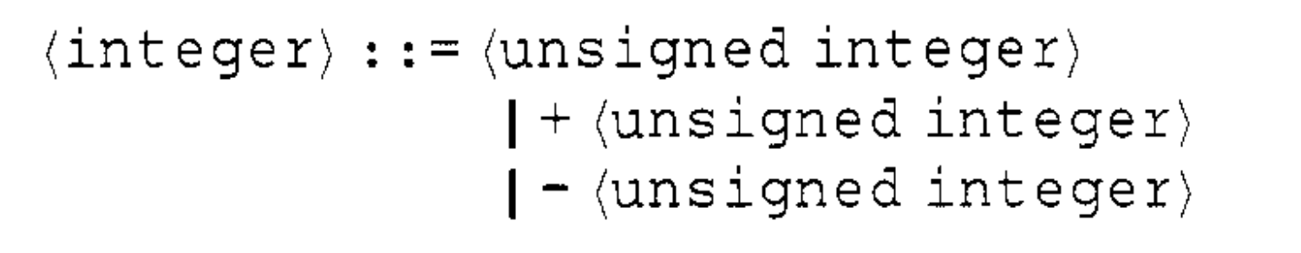
Syntax of eDSLs
with binders
[Ingerman 1967]
data Expr
= Const Integer
| Add Expr Expr
| Mul Expr Expr
[McCracken et al. 2003]
let / λ
Notes:
--
Bonus history slide:
For many years, we have striven for the best syntax representations
In fact, this quest dates all the way back to the 4th century BC with linguist Pāṇini who used what we would call abstract syntax trees (ASTs) to describe the complex grammar rules of Sanskrit
Since then, we have developed BNF, and today many people in our field will recognise ASTs represented as a Haskell data type like this one

Slide 69
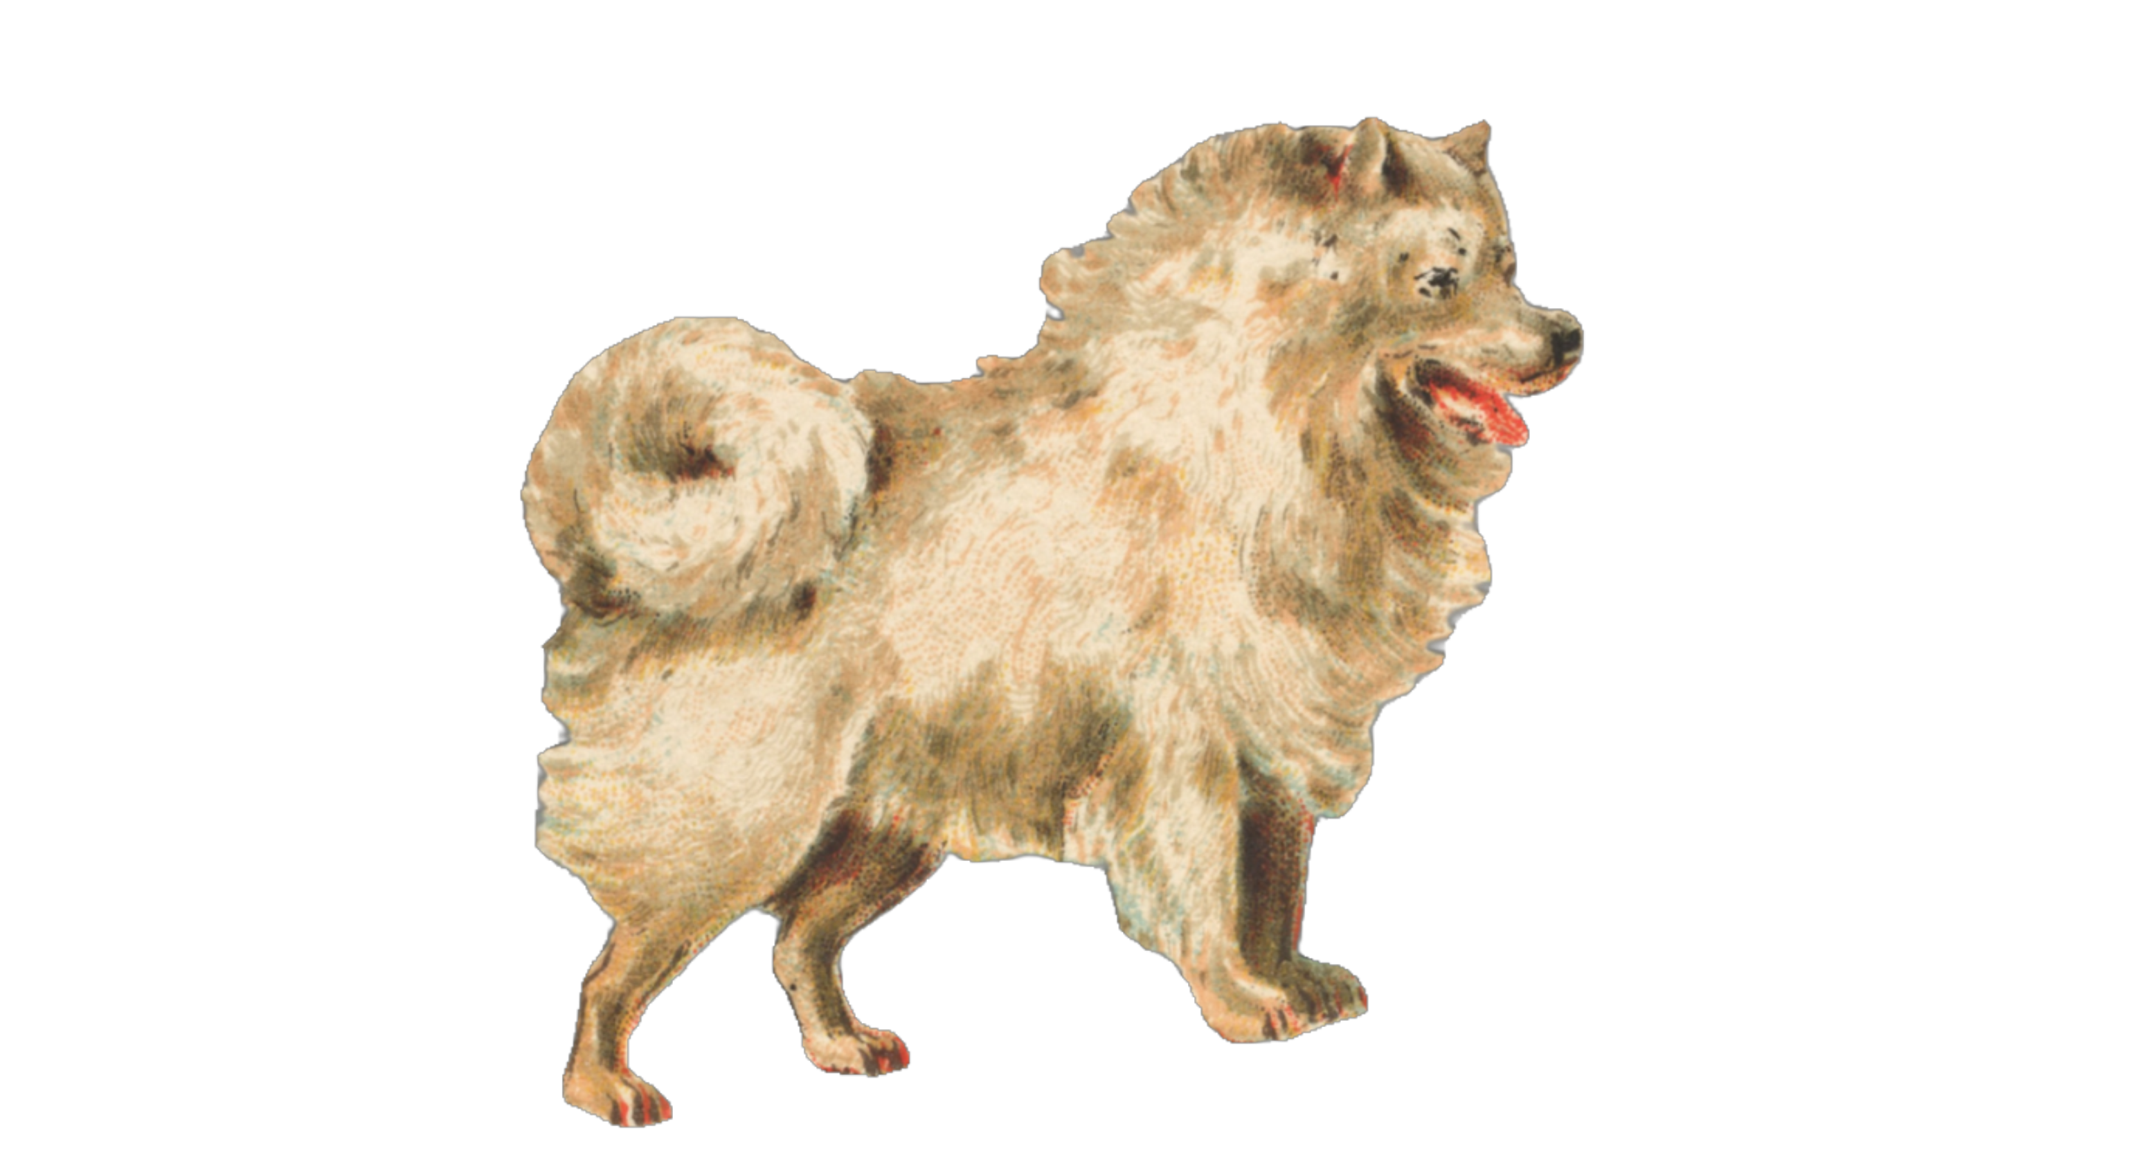
Embedded
Binders
Unembedding
[McDonell et al.]
Notes:
---
Bonus slide for Accelerate
I’d also like to give a shout out to Accelerate: an eDSL of array computations for high-performance computing.
This powerful DSL is of interest to this talk because it is exactly the sort of DSL that could benefit from the embedding technique I will present today: it is embedded, it has binders, and its compilation to GPU code necessitates unembedding

Slide 70
Contextual Embeddings
-- Intrinsically Typed ✅
-- Ergonomic ✅
-- Compatible with Type Theory ✅
-- Isomorphic to First-Order Embedding:
-- * No Exotic Terms ✅
-- * Type Safe Unembedding ✅
-- * Back again ✅
contextualise :: DB.STLC ts t -> STLC ts t
contextualise (DB.Apply e1 e2) = Apply (contextualise e1)
(contextualise e2)
contextualise (DB.Lambda e) = Lambda (\_-> contextualise e)
contextualise (DB.Var i) = toCVar i
$$i=\left|Γ_{use−site}\right|−|Γ_{bind−site}|$$
$$\left|Γ_{bind−site}\right|=\left|Γ_{use−site}\right|−i$$
Notes:
Bonus slide about contextualise
Contextualise is defined fairly simply:
In the app case, we just recursively map from one embedding to the other
In the lam case, we can ignore the proxyTop argument because the index with all the information we need to create the correct ProxyTop will also lie in the var case
Then the var case is a little more involved: Full details in the paper, but we are just using a rearrangement of our equation from earlier. This time, we have the de bruijn index and the use-site context from i and we want to calculate the bind-site context. That is what toCVar does

Slide 72
Style
Titles
Text font
Code font

